Slide 1
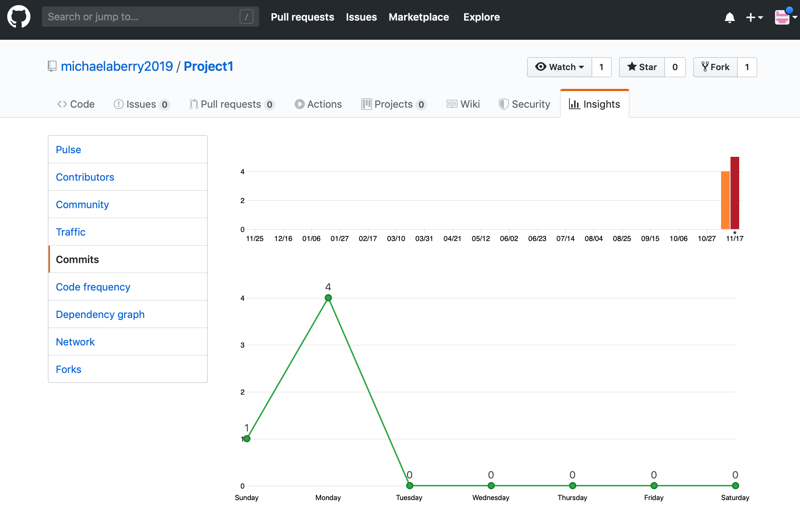
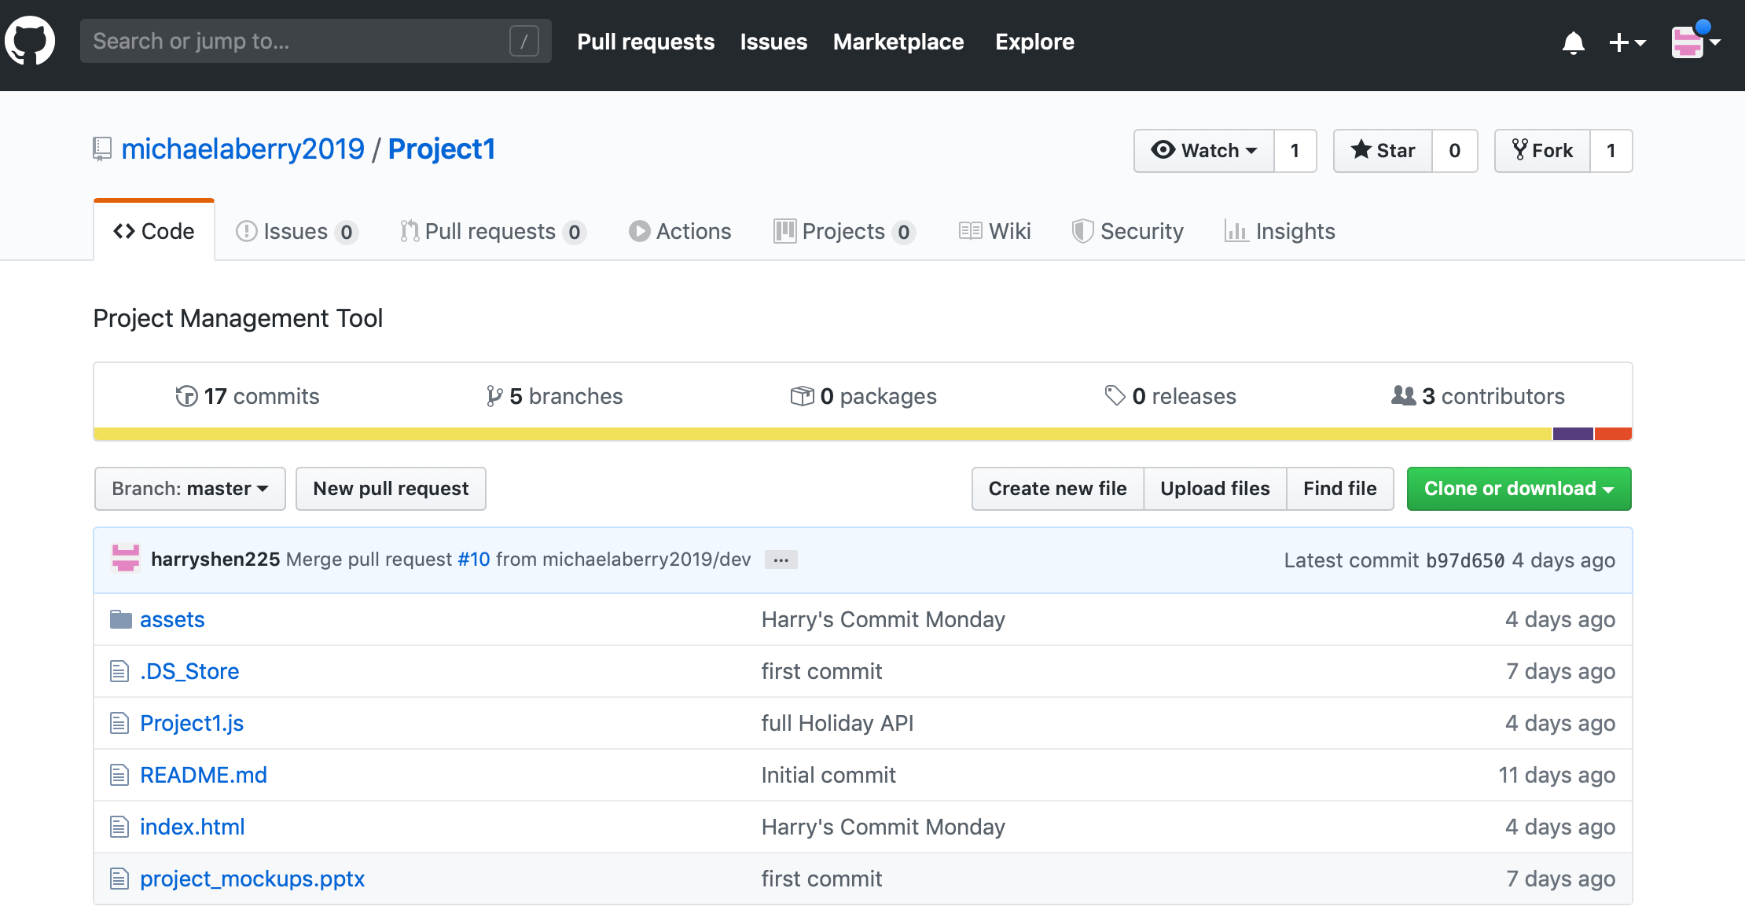

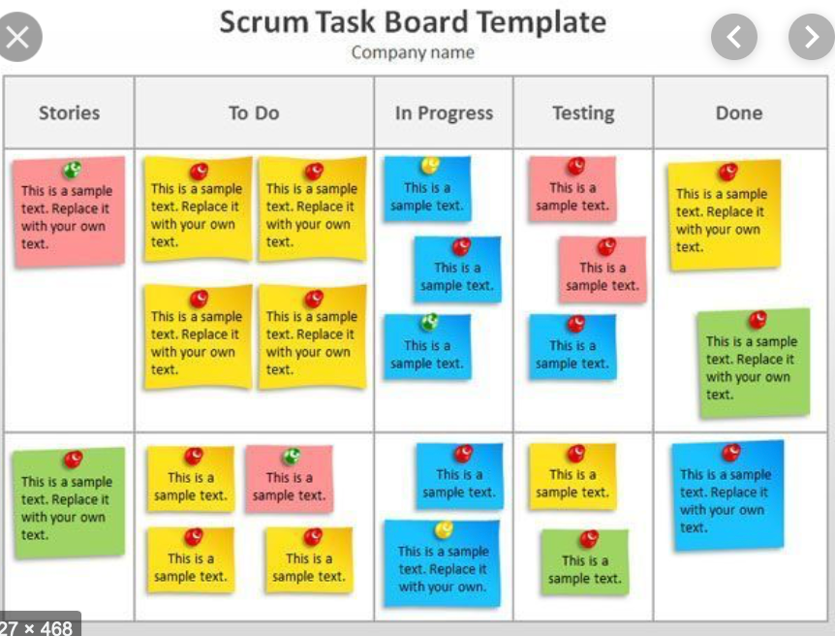
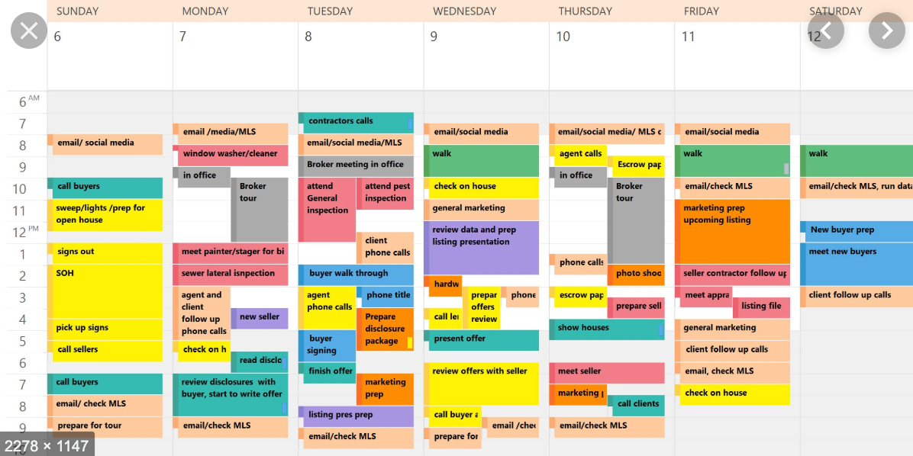
Do you have these questions during your project?
What is the project is really for?
Who are the team members?
What tasks need to be done?
Oh My… Information is everywhere!!!
What does the schedule look like?
How is the team performing?
Who is doing what?
What are the milestones?

Slide 2

Introducing……

Slide 3
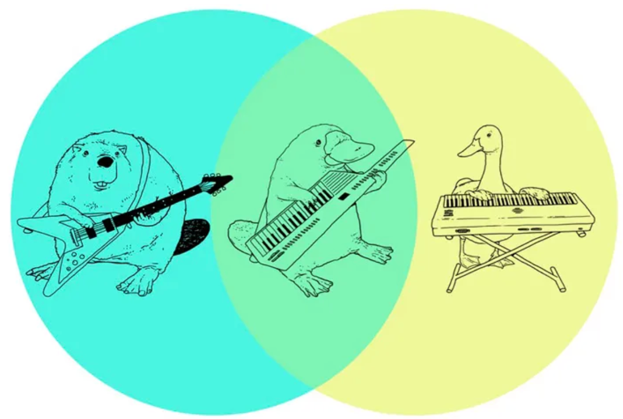
But what is it solving for??
Single Pane of Glass
Milestone Tracking
Team Management
Reporting and Analytics
Task Management

Slide 4







Edge Technologies
Frameworks
APIs

Slide 5


Yes, we had challenges ….
Grand Vision
Reality

Slide 6
Product Packaging – Free and Pro
 | Free | Pro
Things are WORKING | Yes | Yes
Things are NOT WORKING | NO | Assume Yes

Slide 7
DEMO Time!!!

